Slide 1
Mid-Coast Water Planning Partnership
May 31, 2017

Slide 2
Welcome
Mid-Coast
Water Planning
Partnership
Notes:
TIM – Welcome
Ask Partners to raise their hands
Ask Coord Committee members to raise their hands
Ask ‘first-timers’ to raise their hands

Slide 3
Objectives for tonight
Finalize Technical Work Plan and begin developing information.
Review and finalize Communication and Outreach Plan
Sign the Charter – adopted 3/29/17
Identify next steps and initiate Step Two
Notes:
FACILITATORS
We hope to finish up the Charter tonight. At our May 31 meeting we will focus on finalizing the Technical Work Plan.

Slide 4
Meeting guidelines
Future focused
Spirit of togetherness
All viewpoints matter
Strive to understand
Practice patience
Seek win-win
Identify yourself
Help us stay on track
Be present
Notes:
FACILITATORS

Slide 5
Planning process and schedule
WE ARE HERE
2016/17
2017
2018
2019
Step 1:
Build a collaborative process
Step 2: Understand the system
Steps 3/4:
Identify Needs & Solutions
Step 5:
Develop Action Plan
Notes:
Wrapping up Step 1
Beginning work on Step 2

Slide 6
Collaborative Planning for our Water Future
PBP Workshop in Bend –
Wayne Hoffman
John Stevenson
Caroline Bauman
Harmony Burright
Tim Gross
Adam Denlinger

Slide 7
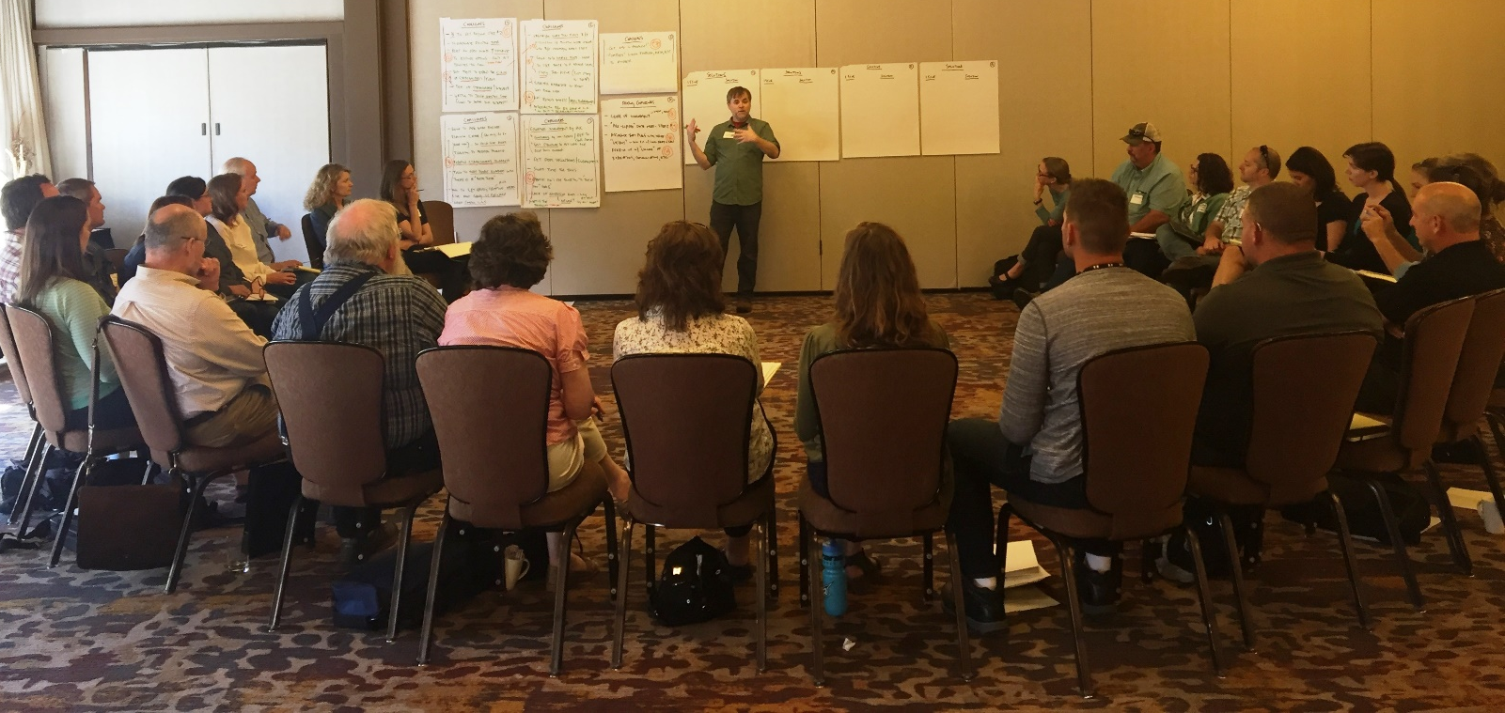
Collaborative Planning for Our Water Future

Slide 8
Highlights of Bend Workshop
Collaborative planning takes TIME – yields BIG BENEFITS
Stay focused on goals
Relate our plan to the IWRS
Words of Wisdom from those who have gone before us . . .
Build relationships based on common values and trust
Ask people what they think . . . Listen, stay open minded
Be transparent
Keep decision making local
Don’t think of it as developing a ‘plan’ but rather a way to work together to solve ongoing problems

Slide 9
Technical Work Plan
Overview
Table Group Discussions: 2 Rounds
Study Group Sign Ups

Slide 10
Aging Infrastructure (Lack of Funds)
Watershed Health
Recharge Aquifers
Water Quantity and Quality
Regulations
Water Storage Capacity
Limited Supply to Meet Future Demand
Seasonal Flows
Lack of Coordination of Drinking Water Systems
Climate Change/ Natural Forces
Key Issues
Balance Needs to Support Water Cycle
Develop new water sources
Agree to Work Together
Water Conservation
Funding (lack of)
Need to Develop Support
Water Reuse
Reduce water loss
Education
Challenges are unique to the coast
Technical Work Plan
Notes:
GSI

Slide 11
Information leads to solutions
Characterize Water Resources
Integrated Plan
Strategies
Needs & Solutions
Notes:
Step 2: Characterize Water Resources – we are developing the ‘big picture’
As we continue through the process, we will develop more specific information

Slide 12
Step 2: Characterize Our Water Resources
Objectives
Information
Develop common understanding of our water resources
Inventory existing data and identify data gaps
Estimate feasibility/cost to address data gaps
Context
Water Quantity
Built Systems
Water Quality
Ecology
Funding

Slide 13
Information tells the story
Outcomes . . .
Report characterizing our water resources to develop common understanding
Summary of data gaps
Estimates of the feasibility/cost to address data gaps
Notes:
Work has already begun . . . We need your help to make sure we are reviewing all the existing information and identifying where we have important data gaps

Slide 14
Understanding the ‘Big Picture’

Slide 15
Understanding the ‘Big Picture’

Slide 16
Work Flow – Your Involvement
PP = Planning Partnership
CC= Coordinating Committee
‘Field Trips’
to support
planning process
SG
SG
Study Groups
SG
SG
Notes:
P = PARTNERSHIP
CC = COORDINATING COMMITTEE
FG = RESEARCH BY CONSULTANT AND FOCUS/WORK GROUPS

Slide 17
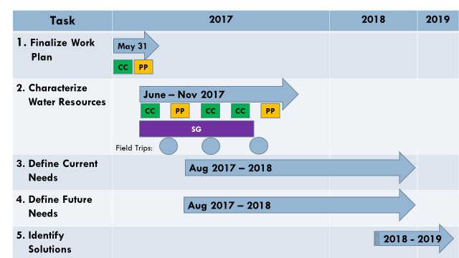

Slide 18
Technical Work Plan – Questions
Structure of Work Plan
2.1 Context
2.2 Water Quality
2.3 Built Systems
2.4 Water Quality
2.5 Ecology
2.6 Funding
SG
SG
SG
SG
Notes:
Walk through work plan – We will have 4 study groups that meet twice this summer
ask for large group questions

Slide 19
After Break . . . Table Group Discussions
Table Group Discussions to identify:
Additional resources of information (data & people)
Data gaps
Table Groups:
Context
Water Quantity
Built Systems
Water Quality
Ecology
2 Rounds of Discussion
Notes:
We need your help tonight to identify informational resources and data gaps

Slide 20
Structure and Function
Planning Partnership
Coordinating Committee
Study Group
Water Quantity
Study Group
Built Systems
Study Group
Water Quality
Communication & Outreach
Project Team
Study Group
Ecology
Notes:
Review the Partnership structure – Emphasize 4 Study Groups, Ecology will be discussed at all
We have discussed this pretty extensively since the first meeting
No significant changes – CC just added some clarifying language in a few places

Slide 21
BREAK
Sign the Charter during Break!
Not a ‘legal’ document – non binding
Signing indicates agreement with the mission, goals and operating agreements

Slide 22
Table Group Discussions: Round 1
DISCUSSION GROUPS
PROCESS
Context
Water Quantity
Built Systems
Water Quality
Ecology
Review list of information already gathered
Identify additional existing information resources
Identify data gaps
Prioritize information – top 5
BRIEF REPORT OUT – 2 MIN/TABLE

Slide 23
Table Group Discussions: Round 2
DISCUSSION GROUPS
PROCESS
Context
Water Quantity
Built Systems
Water Quality
Ecology
Review list of information already gathered
Identify additional existing information resources
Identify data gaps
Prioritize information – top 5
BRIEF REPORT OUT – 2 MIN/TABLE

Slide 24
Sign Up for a Study Group
June 21
June 22
Water Quantity
9:30 - noon
Built Systems
9:30 - noon
Water Quality
2 – 4:30 pm
Ecology
2 – 4:30 pm
Notes:
Invite folks to sign up for a study group – sign up at flip charts on wall

Slide 25
Communication & Outreach
Introduce working group
Review the CEO Plan
Review plan for Field Trips
Notes:
Introduce Working Group Members

Slide 26
Communication & Outreach Plan
Foundational plan – will evolve over time.
Guides/supports Partnership communication, education, outreach.
Goal based Plan – tools and strategies will be developed to achieve Partnership goals.
Materials will be maintained online.
Working Group - distributed leadership model. Working group members will lead in areas of interest / expertise.

Slide 27
Activities to Date
2016
2017
Initial communication tools/activities
Initial Partnership database
Invitation letters & emails
1-on-1 Outreach
Mailing list (145 subscriptions)
Partnership website www.midcoastwaterpartners.com
CO Working Group formed
Draft CO Plan developed
Next Steps identified
Partnership review of Plan

Slide 28
Contents of CO Plan
Purpose / Roles
Supports Partnership Charter
Mission
Vision
Values
Identifies:
Key Messages
Key Audiences
Tools for Communication & Outreach
Goals

Slide 29
Audiences

Slide 30
Goals
Ensure an open and transparent process
Publicize how to find information and opportunities to be involved
Promote partner-to-partner communication
Promote peer-to-peer learning opportunities
Retain current partners
Recruit new partners
Raise awareness of water issues on the coast and the planning effort
Solicit public input

Slide 31
Opportunities to get involved
Planning
Partnership
Coord
Comm
Study Groups

Slide 32
Field Trips - PROPOSED
Field Trip 1 – week of 7/24/17
Theme: Watershed Processes
Salmon River Watershed
Field Trip 2 – week of 9/25/17
Theme: Watershed quantity and supply
Siletz River Watershed
Field Trip 3 – week of 11/1/17
Theme: Build infrastructure
Waldport / Yachats

Slide 33
Next steps
Initiate Study Groups: June 21, 22
Water Quantity
Water Quality
Built Systems
Ecology
Field Trips – July, September, November
Coordinating Committee Meetings: Schedule July - October
Partnership Meetings – August 8 and November 14, 4 – 7 pm
Notes:
Handout the schedule

Slide 34
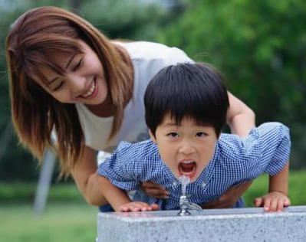
Thanks . . . and keep in touch!
www.midcoastwaterpartners.com

