Slide 1
Municipal and Special District Work Group (Muni/District)
October 30, 2018

Slide 2
Re-cap of Muni/District Report Partnership Meeting May 30, 2018
Major issues as identified by survey respondents
Water Quantity
Infrastructure
Water Quality
Lack of Regional Collaboration
Financing
Potential Solutions
Collaboration with neighboring water providers
Infrastructure improvements
Additional water sources
Water conservation

Slide 3
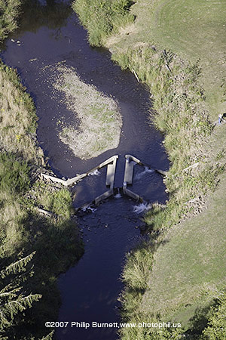
Four Critical Issues (1-3)
1.
Lack of collaboration between Muni-District water suppliers is an overarching issue affecting prioritization
2.
Water conservation opportunities; potential exists to develop a regional water conservation consortium
3.
Insufficient supply and supply vulnerabilities for groundwater, springs, streams

Slide 4
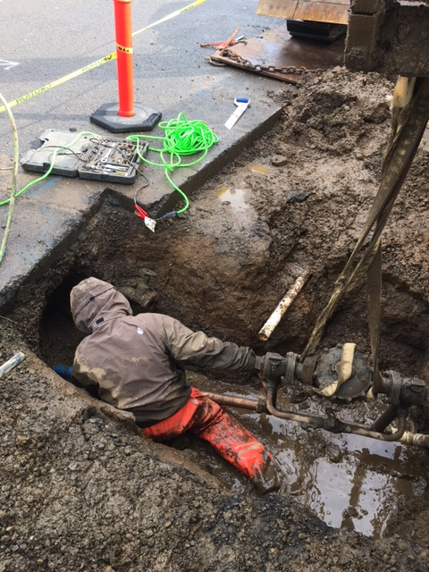
Four Critical Issues (4)
4a.
Critical water infrastructure needs exist throughout the region.
4b.
Water infrastructure funding/grant programs are needed to support regional capacity, age, and resiliency improvements

Slide 5
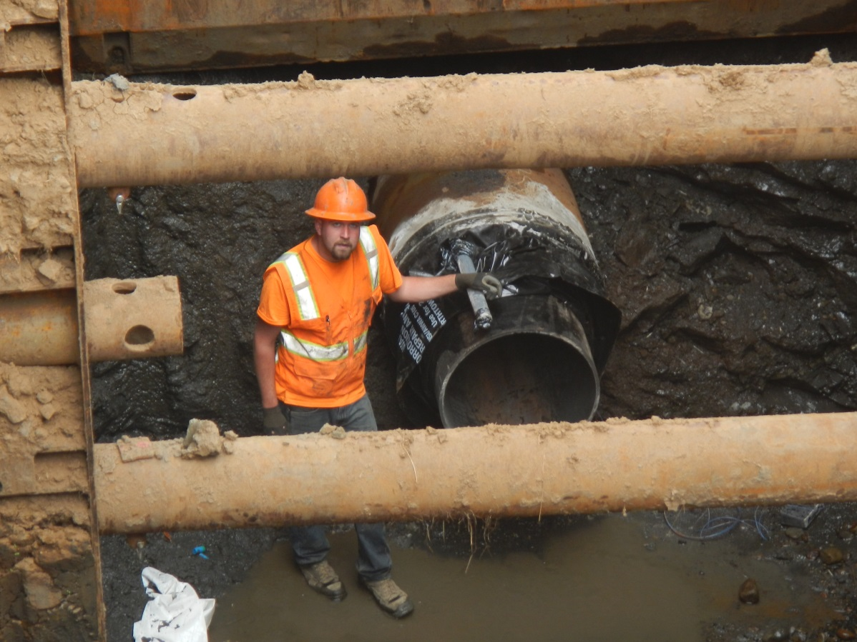
Focus Issue: Water Quantity/Availability for Municipal Use
Problem Statement:
Limited communication between water providers in the region who make decisions independently when we could be making them collectively.

Slide 6
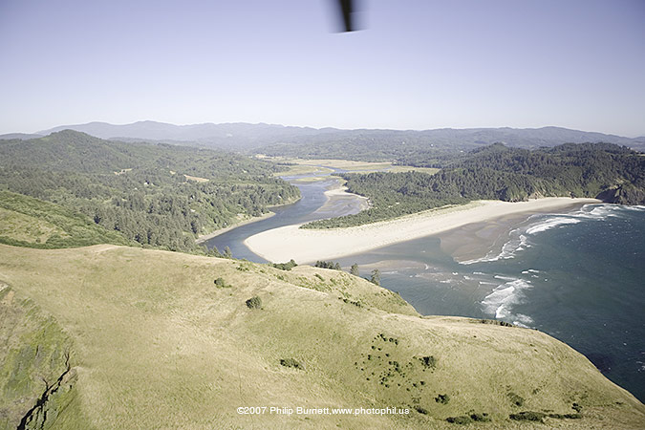
Focus Issue: Water Quantity/Availability for Municipal Use
Goal Statement:
Promote opportunities to improve communications, share knowledge, pool resources, etc.

Slide 7
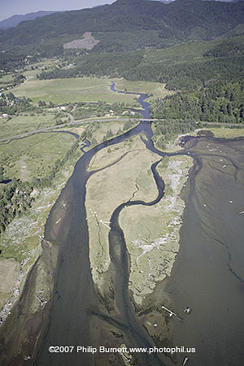
Focus Issue: Water Quantity/Availability for Municipal Use
Learning Plan
What opportunities exist for system collaboration?
Do all water providers in the region desire opportunities for interconnection and mutual aid?

Slide 8
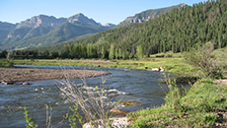
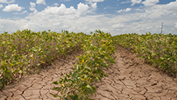
Focus Issue: Water Quantity/Availability for Municipal Use
Applications
Click a category below to see what tools are available to help with decision making in fire, water management, agriculture and climate monitoring.
WILDFIRE
WATER
AGRICULTURE
CLIMATE
Assistance
Army Corps of Engineers
CIRC’s Northwest Climate Toolbox

Slide 9
Focus Issue: Water Quantity/Availability for Municipal Use
Action Plan
Continue to attend focused discussions centered around mutual aid and partner collaboration.
Develop opportunities for collaboration with State Agencies.
Work proactively with State and Federal agencies to use existing funding resources to support regional water supply solutions

Slide 10
Focus Issue: Water Quantity/Availability for Municipal Use
Outputs
Maps/GIS files that compile existing information related to neighboring communities that may support opportunities for shared source water for developing emergency inter-connections
Coordination
Learn about water supply, vulnerabilities/concerns, from other water suppliers regarding infrastructure and emergency preparedness
Nuts and Bolts
It’s important to continue to meet as a working group…establish a date/time that accommodates participates to continue monthly WG meetings

Slide 11
Developing a Mid-Coast Water Conservation Consortium
Objectives
To increase water conservation, particularly during the summer
To increase resiliency during droughts and emergencies
To pool the resources of multiple water providers to accomplish more water conservation activities than what could be accomplished individually
Potential Services and Activities
All services/activities/outreach would be tailored for the Mid-Coast, and some could be tailored for individual water providers.

Slide 12
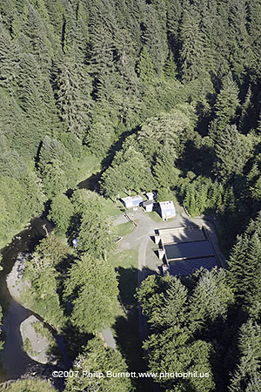
Consortium Potential Activities
Public Education and Outreach
Website, articles, billing messages Provide social media messaging
Coordinate watershed/water system tours
Promote water conservation at events (Create and staff a booth)
K-12 Education
Programs for Businesses, Motels/Hotels, and Rental (Apartments and Vacation) Management Companies
Giveaways, Rebates, and Grants
Technical Assistance
Manage residential indoor and/or outdoor water audit program
Develop a water-wise landscaping guide for the Mid-Coast

Slide 13
Consortium Potential Activities
Curtailment and Drought Declarations
Coordinate water curtailment plans of water providers on the Mid-Coast
Develop drought declaration and water curtailment messages
Administration
Manage administration of the consortium
Intergovernmental Agreements

